Slide 1
04
Summary and Resources
Python Programming for Linguists
Ingo Kleiber, 2020

Slide 2
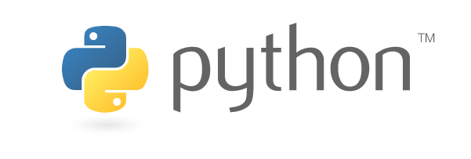
Learning Objectives
After completing this workshop, you will be able to ...
describe what programming essentially is about.
name and describe some basic programming terminology.
model simple problems in terms of data structures and basic algorithms.
write basic scripts in Python in order to solve specific problems.
utilize third-party libraries such as NLTK, spaCy, and TextDirectory.
construct and apply basic regular expressions.
utilize Python for text manipulation.
utilize Python to perform concordance and frequency analysis.
automatically annotate texts (PoS, Universal Dependencies, NER) using spaCy.
scrape web data in order to build corpora (Web as Corpus) using Python.
compute basic statistics using Python.

Slide 3
What You Might Have Missed
Go back to the early exercises and attempt them again. Maybe try to optimize or extend your solution.
Have a look at the Command Line Primer and experiment in a notebook.
Have a look at the Commenting in Python primer.
Have a look at the bonus notebook Understanding Classes and Objects.

Slide 4
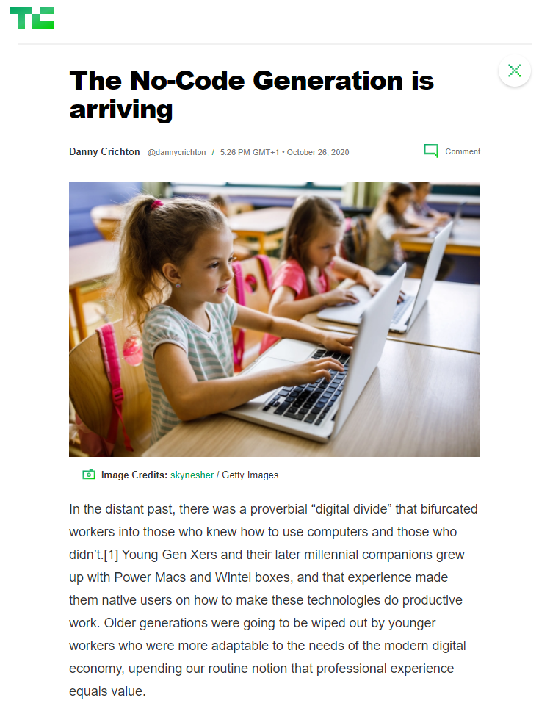
The No-Code Generation
Do you need to know how to code?
“Of course, no-code tools often require code, or at least, the sort of deductive logic that is intrinsic to coding. You have to know how to design a pivot table, or understand what machine learning capability is and what it might be useful for. You have to think in terms of data, and about inputs, transformations and outputs.”
(Danny Crichton, TechCrunch)
https://techcrunch.com/2020/10/26/the-no-code-generation-is-arriving/

Slide 5
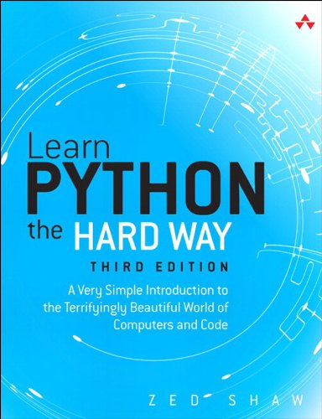
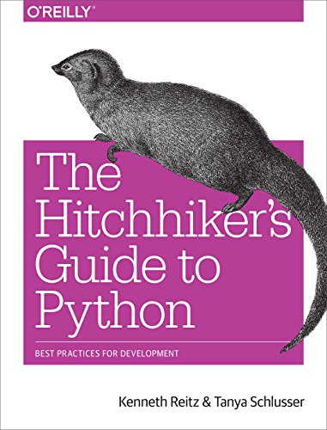
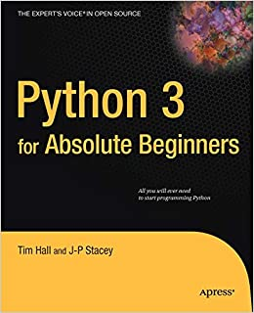
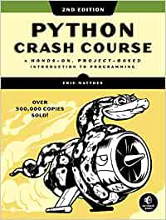
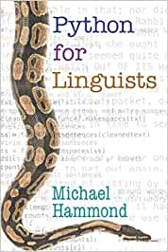
Books
Some (Careful) Recommendations
by Zed Shaw
(Addison-Wesley Professional)
by Kenneth Reitz & Tanya Schlusser
(O'Reilly)
by Tim Hall & J-P Stacey
(Apress)
by Eric Matthes
(No Starch Press)
by Michael Hammond
(Cambridge University Press)

Slide 6
Online Courses
Codecademy
DataCamp
Talk Python Training
Django Girls
FreeCodeCamp
fast.ai A Code-First Introduction to Natural Language Processing

Slide 7
Other Resources
Podcast Talk Python To Me by Michael Kennedy
PyCon (several conferences, see pycon.org / YouTube)
Peter Norvig’s pytudes (on GitHub)
Stanford NLP’s CS224n: Natural Language Processing with Deep Learning

